Slide 1


Reconstruction of 4Р105 “Darband – Boysun” on the section 5-70km and 4Р100 “Manguzor-Jarkurgon-Bandixon-Oltinsoy-Devon” on the section 128-174 km
Translated from Russian to English - www.onlinedoctranslator.com
Tashkent - 2025

Slide 2

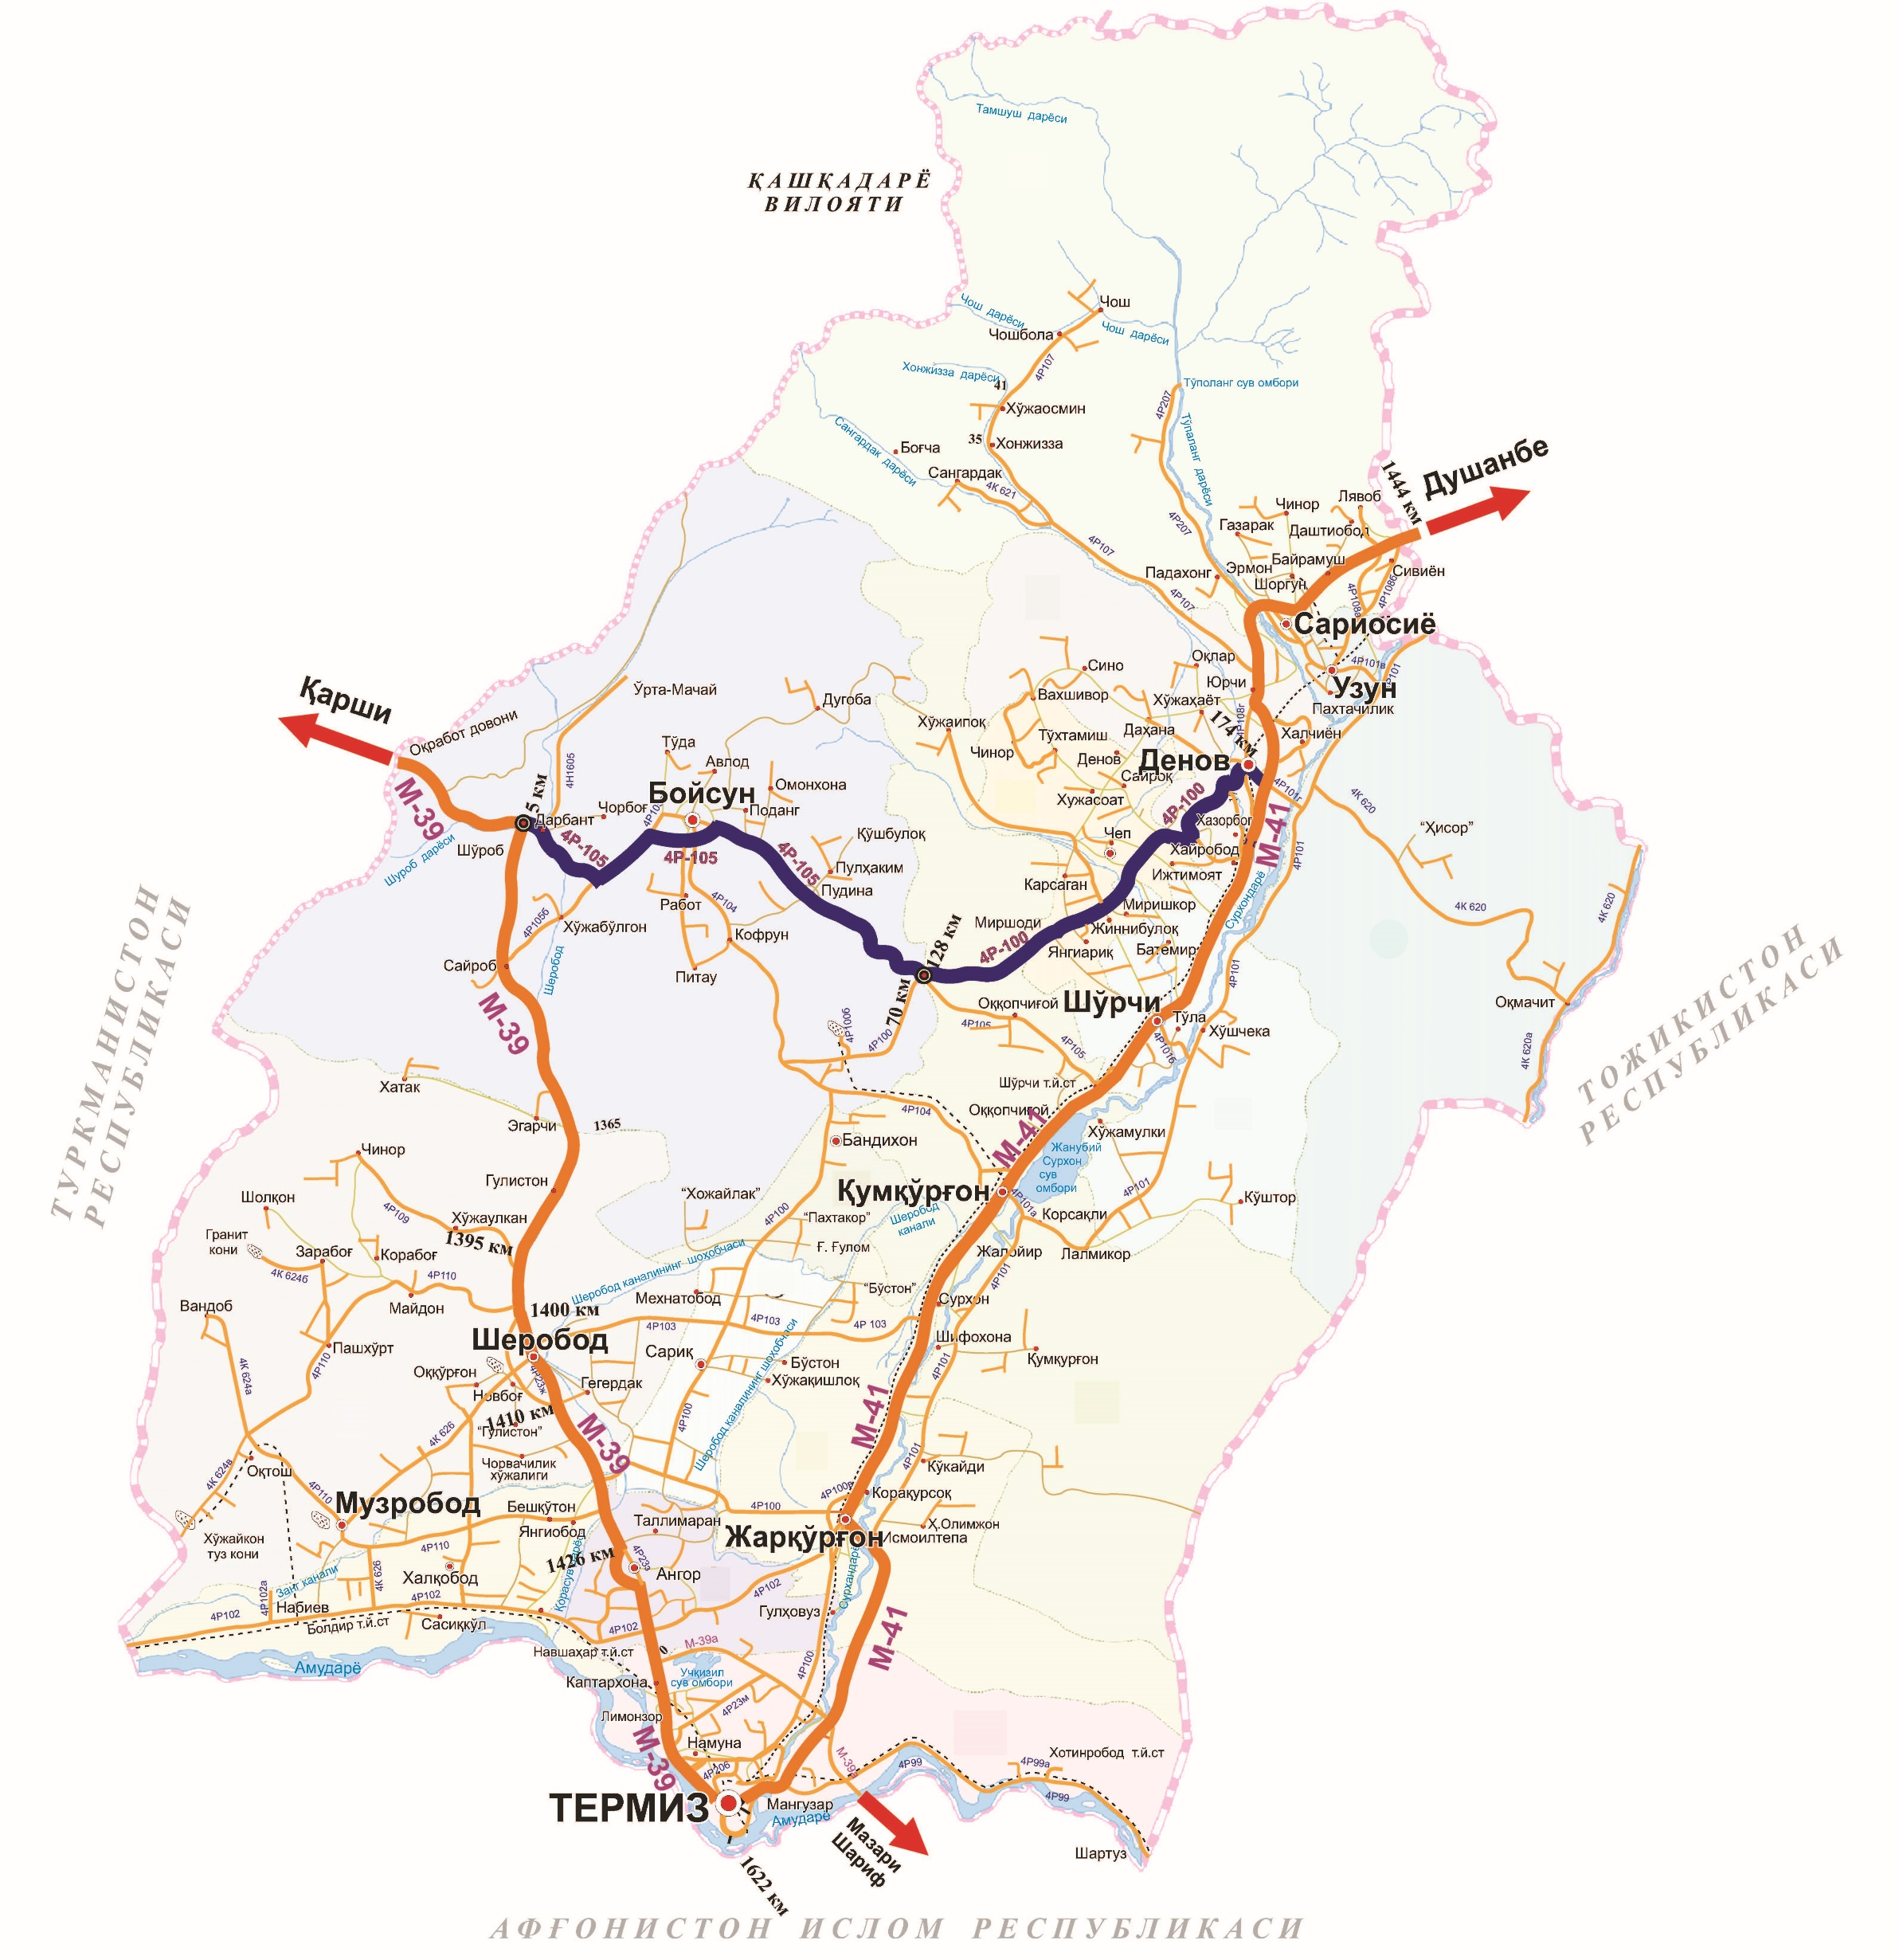

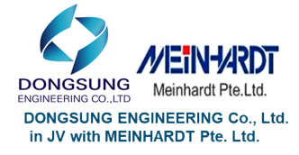
Project “Reconstruction of 4Р105 “Derband-Boysun-Elbayon“ on the section 5-70km and 4P100 "Manguzor-Zhargurgan-Bandikhon-Altynsai-Denau“ on the section 128-174km
Decree :Presidential Decree dated April 4, 2022 No. PQ-189 Republic of Uzbekistan
Project length:111 km
Project implementation area:districts of Surkhandarya region such as Boysun, Kumkurgan, Bandikhon, Altynsai and Denau
Project implementation period:2022-2027
The total cost of the project :227.3 million US dollars, of which loans from the Asian Development Bank - 183.8 million US dollars, and the share of the Republic of Uzbekistan - 43.5 million US dollars.
Chief designer:LLC “Yo’l loyiha Byurosi"
Employer: Agency "Avtoyulinvest" under the Committee for Roads.
 | Project contractor: LANKARAN YOL TIKINTI OJSC Contract value:147.59 mln US dollars. Contract expiration date: May 18, 2027 Current situation(as of 06.04.2026): Construction and installation works commenced in February 2023. To date, US$79,4 million has been paid to the Contractor. Today, the Contractor employs more than 137 vehicles and special equipment, more than 300 foreign and local specialists and workers at the construction site. At present, the contracting organisation is carrying out excavation works, laying of the lower, lower and upper layers of the roadbed, construction of the upper layer of the base with M-75 grade (STB) cement concrete mix 18 cm thick and laying of cement concrete (M-400) pavement 27 cm thick.
 | Construction Supervsion Consultant :Dongsung Engineering Co., Ltd. (Korea) and Meinhardt Pte. OOO". (Singapore) JV Contract value:4.59 million US dollars. Contract expiration date: May 22, 2027. Current situation(as of 06.04.2026): The consultant's technical construction supervision services commenced on 22 November 2022 and the consulting organisation has received USD 4,14 million to date. At present, 19 experts, including 3 international key experts, as well as 16 national key experts, have been engaged by the consulting organisation for the project. According to the contract, they are carrying out the relevant work.

Slide 3
Main technical parameters of the designed highway
No. | Highway | Total road length | Populated part of the road | Unpopulated part of the road | Number of lanes | The width of the line | Road width | Artificial constructions
 |  | km | km | km | number | m | m | Bridges | Pipes
1 | Reconstruction of 4R105 "Darband-Boysun-Elbayon» on the section 5-70km | 65 | 21 | 44 | 2 4 | 3.75 | 15 30.95 34.45 | 11 | 77
2 | Reconstruction of 4R100 “Manguzor – Zharkurgan – Bandikhon – Altynsoy – Denau” on the section 128-174km | 46 | 2 8 | 18 | 2 4 | 3.75 | 15 23.7 30.95 34.45 | 17 | 375

Slide 4
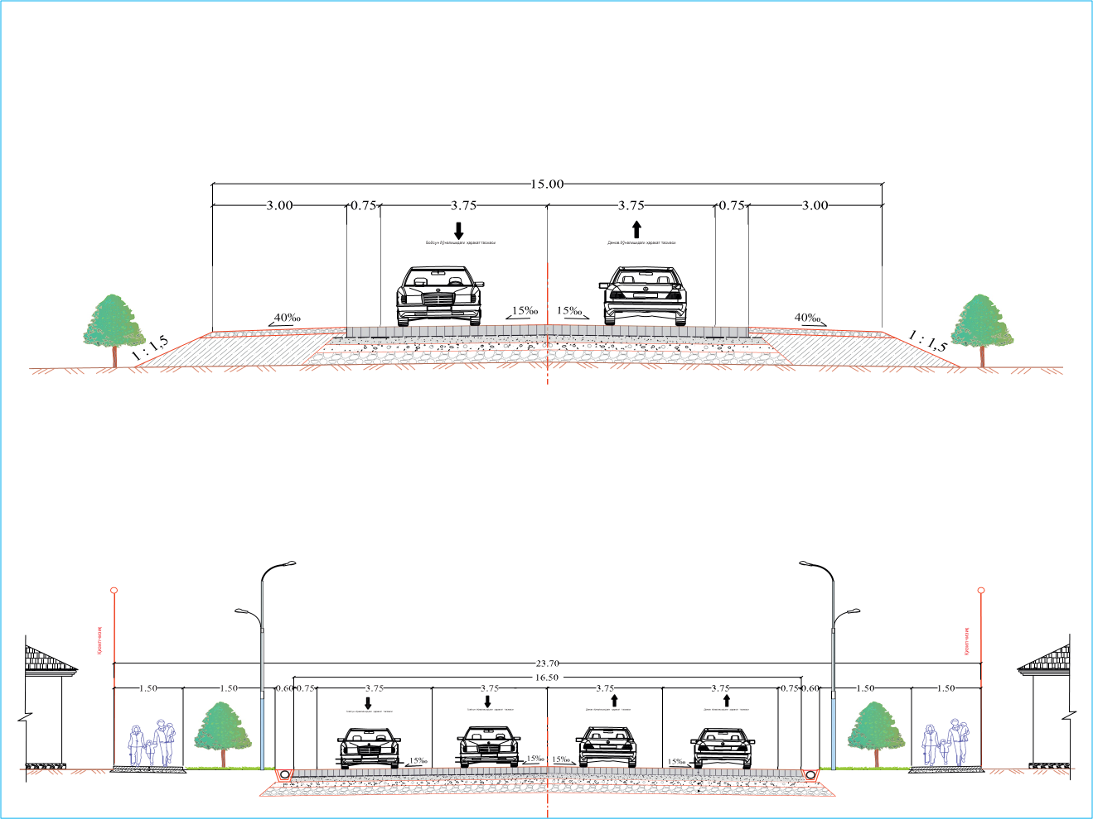
Cross section of the road
Outside residential areas
In residential areas

Slide 5







Results expected from the project
Traffic speeds will increase by an average of 5% per year, resulting in actual motorway capacity increasing from an average of 8 921 vehicles per day to 38 556 vehicles per day by 2049.
The M39 and M41 international highways passing through Surkhandarya province will be merged for a short distance, and the existing 298 km motorway for international and local vehicles travelling to Tashkent city will be reduced to 152 km.
Road maintenance costs will be reduced by nearly 90%, resulting in total savings of 77.08 million US dollars by 2049.
Fuel consumption will drop from an average of 7 litres/100 km to 5 litres/100 km, resulting in total savings of 48.95 million US dollars for car owners by 2049.
Car owners' expenditure on fuel and car parts, tyres, etc. will be reduced, resulting in a total savings of 94.55 million US dollars for car owners by 2049.
The high level of road safety will reduce road accidents by up to 30%, resulting in a saving of 14.68 million US dollars by 2049.
The vehicle's journey time on the road will be reduced by up to 80%.

Slide 6

Thank you for your attention!

